Slide 1
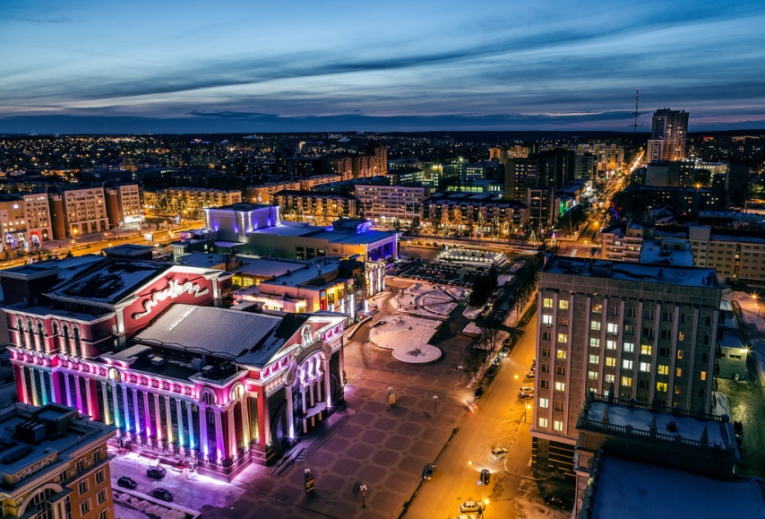
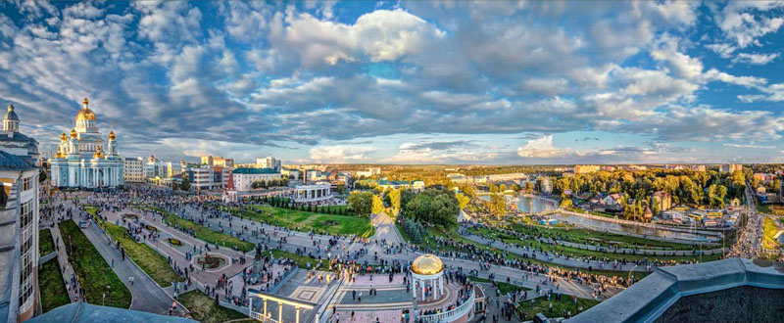
Welcome to Saransk
Welcome to Saransk!
Tour of Saransk

Slide 2
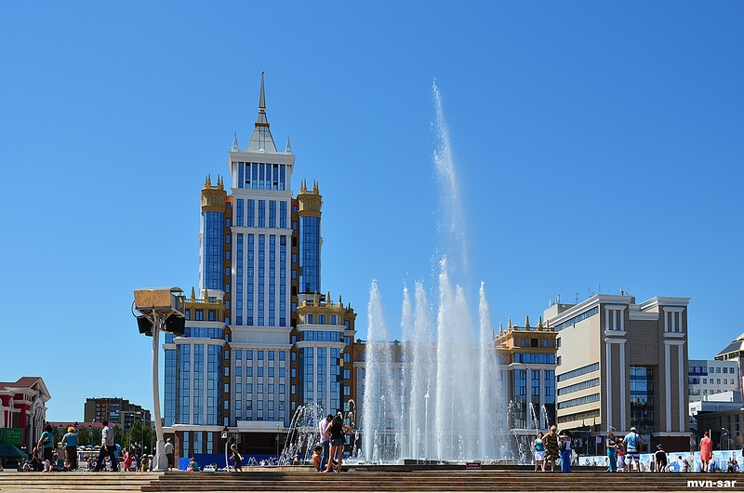
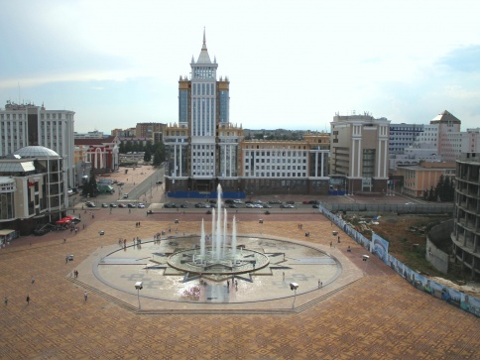
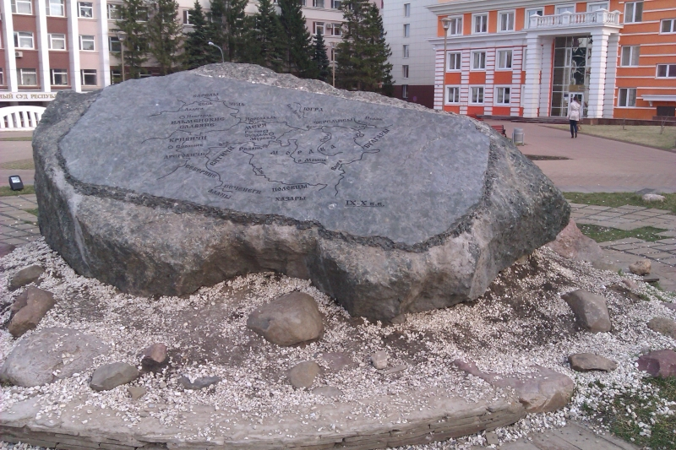
Millennium Square
The Millennium Square was built in 2012.
There is a big stone and there is a big fountain in the Millennium Square.
The big stone contain a map of the Republic of Mordovia.
Fountain "Star of Mordovia" is one of the largest fountains in Russia.

Slide 3
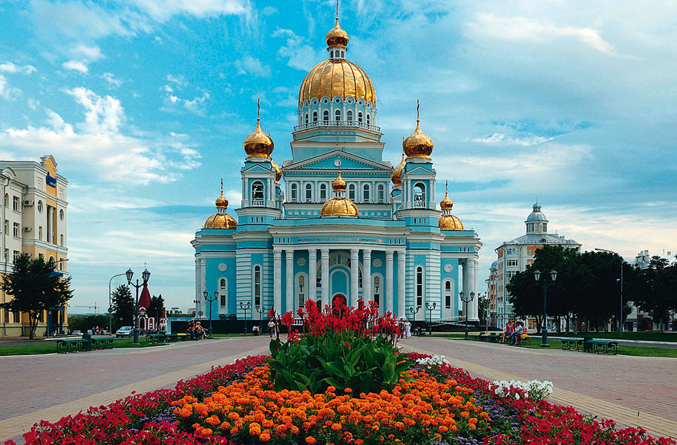
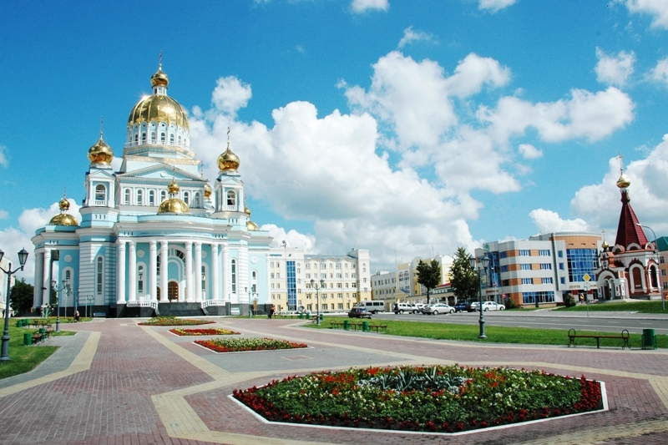
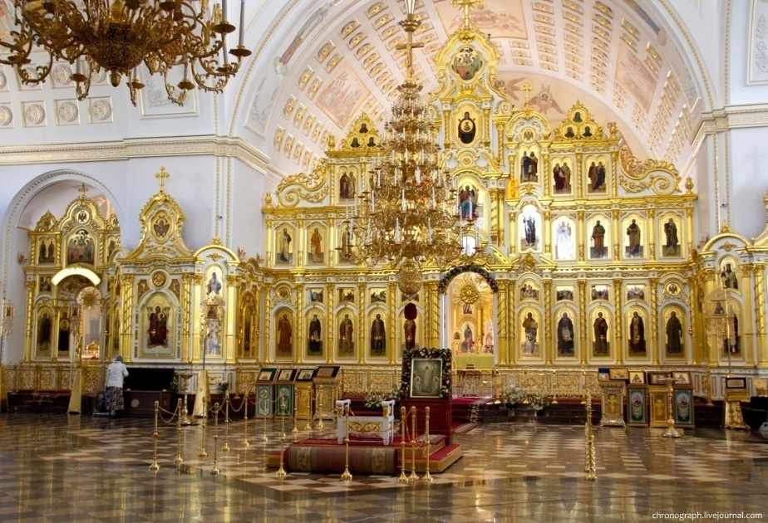
Cathedral Ushakov
Cathedral of the holy righteous warrior Feodor Ushakov - Orthodox Cathedral in Saransk

Slide 4
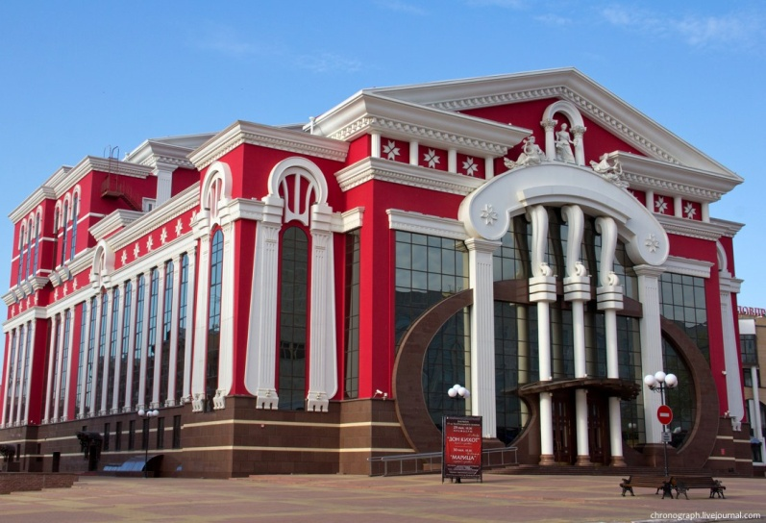
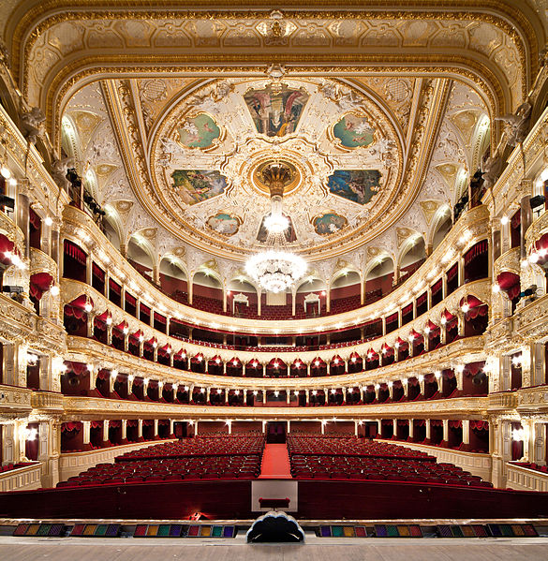
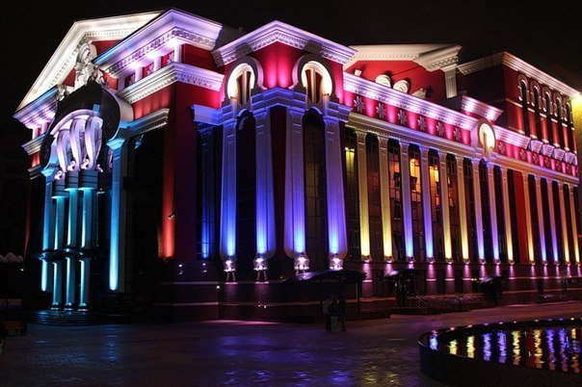
Opera and Ballet Theatre
The history of Yaushev's theater began back in 1935, when the Mordovia Theater of Musical Comedy was founded.

Slide 5
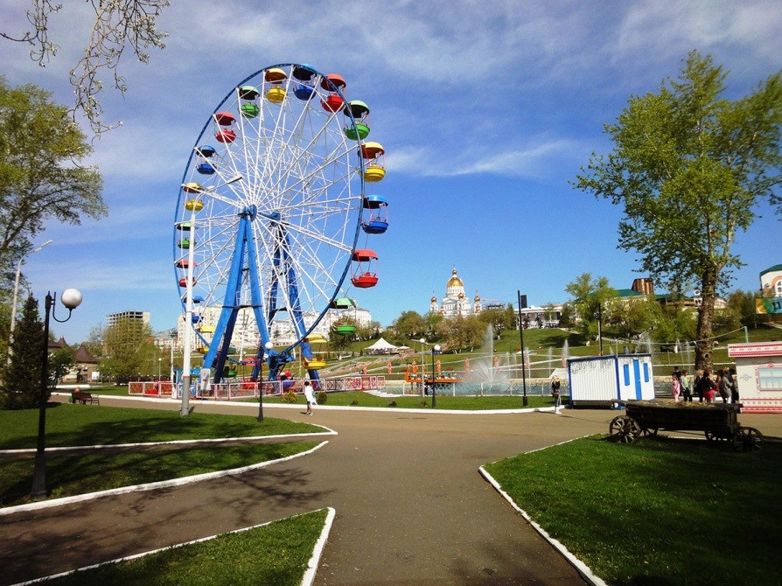
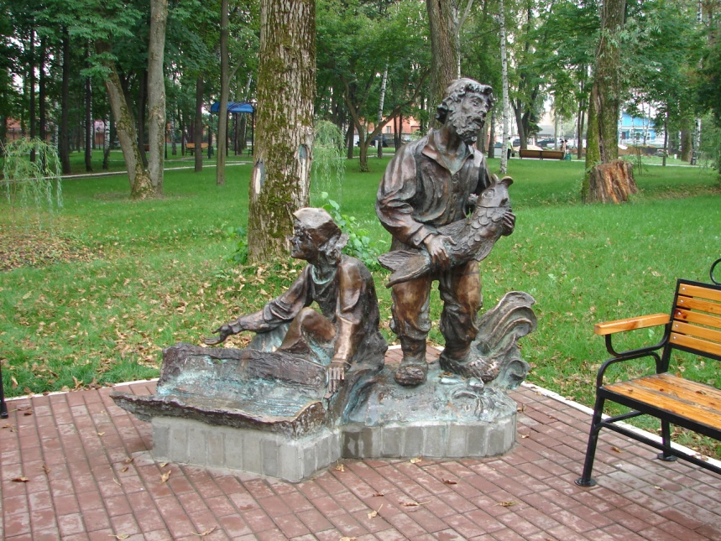
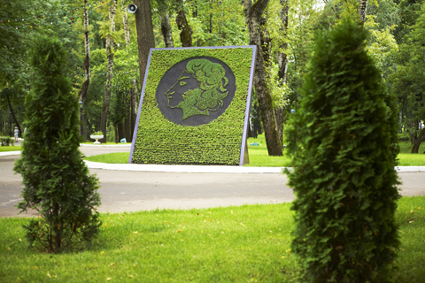
Pushkin Park
Pushkin Park today is one of the best in the Russian Federation. The park has become a place of rest for people of different ages, interests and preferences, the pride of our capital, the main venue for large-scale events.

Slide 6
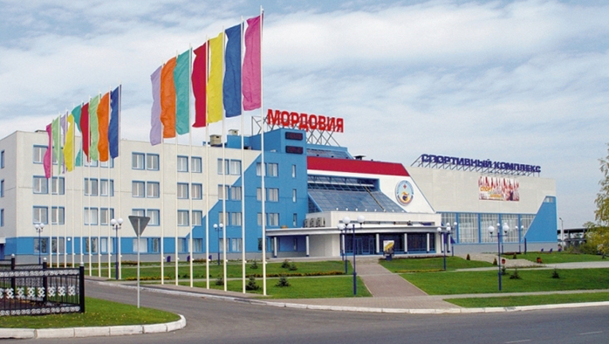
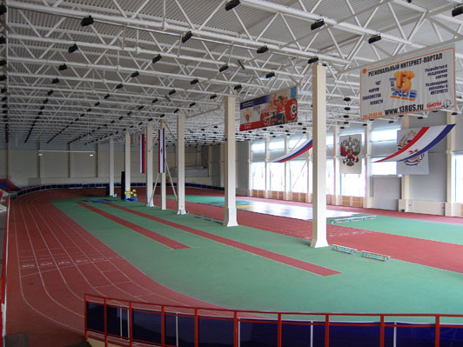
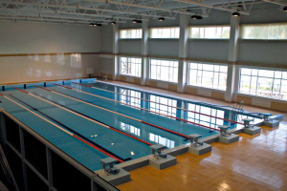
Sport complex Mordovia
The Mordovia sports complex is one of the largest sports facilities in the Republic of Mordovia.
The sports complex started its work in 2004.
The sports complex allows to make contests for basketball, boxing, karate, volleyball, sambo, sports dances, mini-football and other sports.

Slide 7
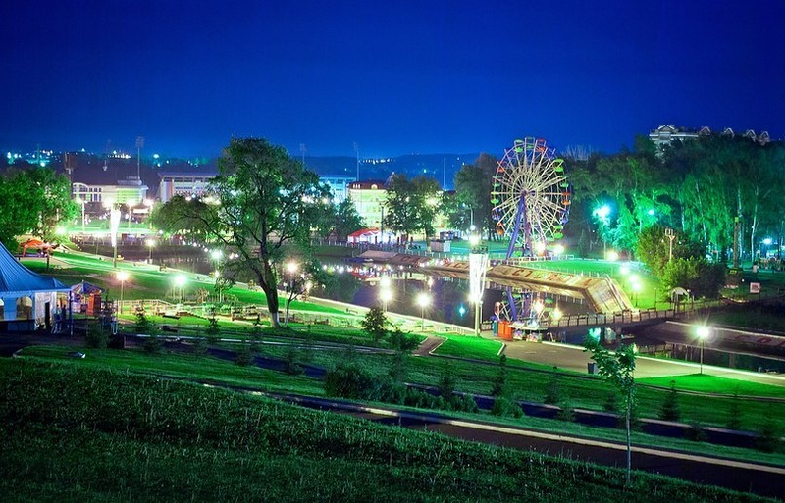
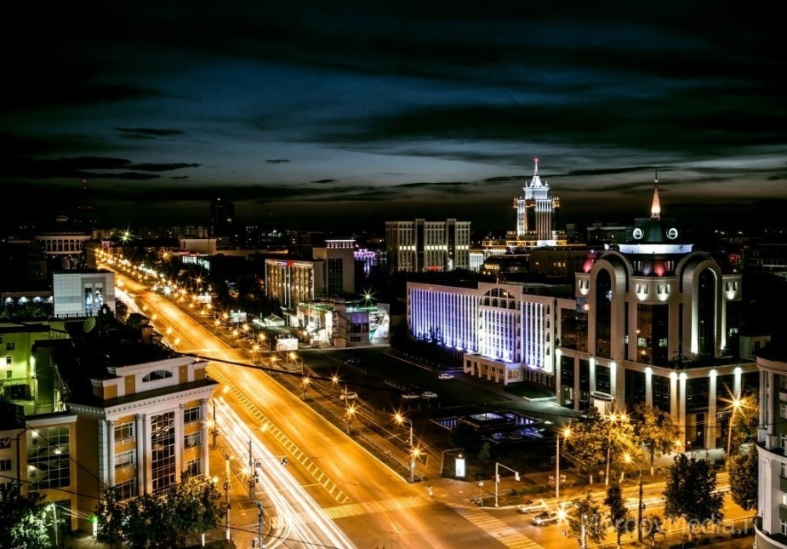
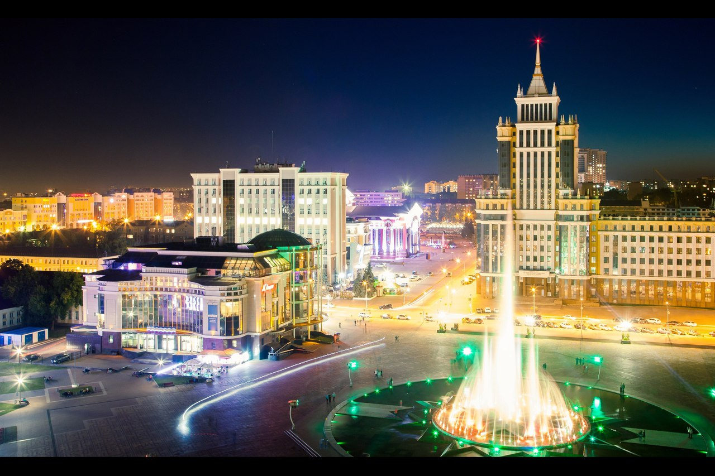
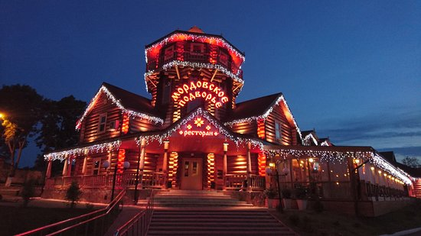
Night Saransk

