Slide 1
<
=
>

Slide 2
<
=
>

Slide 3
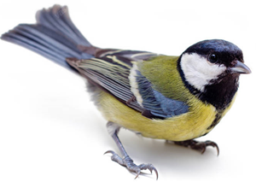
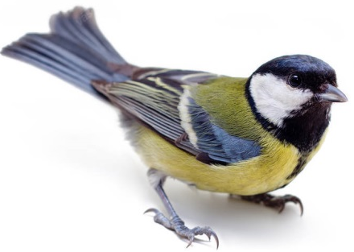
<
=
>

Slide 4
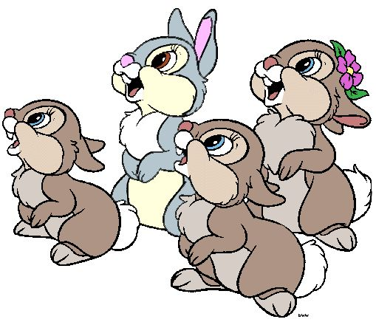
<
=
>

Slide 5
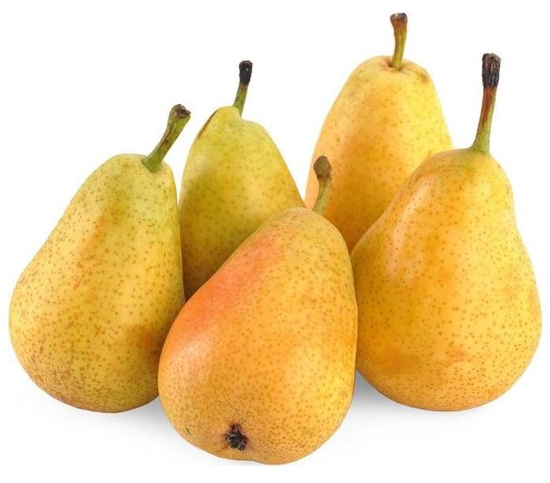
<
=
>

Slide 6
<
=
>

