Slide 1
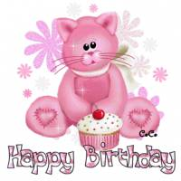
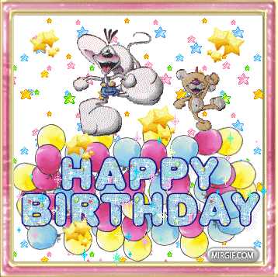
HAPPY BIRTHDAY

Slide 3
’’’’ 7=s es

Slide 4
ROSES

Slide 5
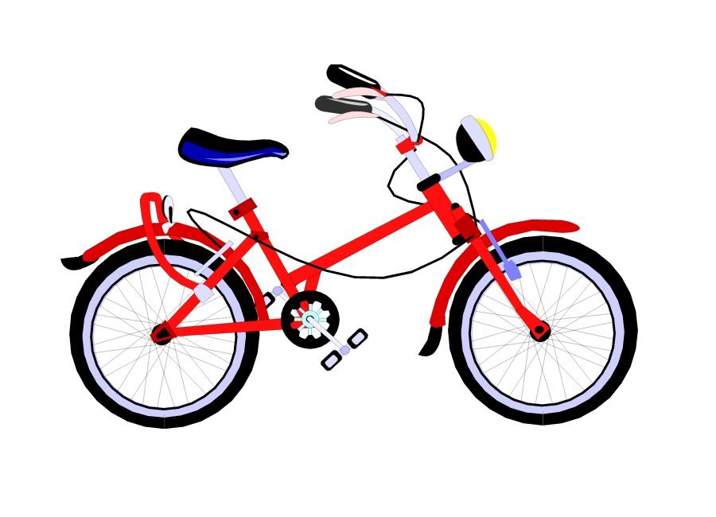
’ ’’

Slide 6
CAKE

Slide 7
D , 2=O

Slide 8
DOLL

Slide 9
b ,

Slide 10
BOOK

Slide 11
What colour is it?
E.g. The coin is grey.

Slide 12
HOW MANY…?
4+5=? – Four and five is nine.
Friends: 6+2=?
Family: 5+8=?
Flowers: 7+5=?
Toys: 8+9=?
Sweets: 10+10?
Coins: 13+1=?
Cakes: 1+1=?
Books: 9+4=?

Slide 13
