Slide 1
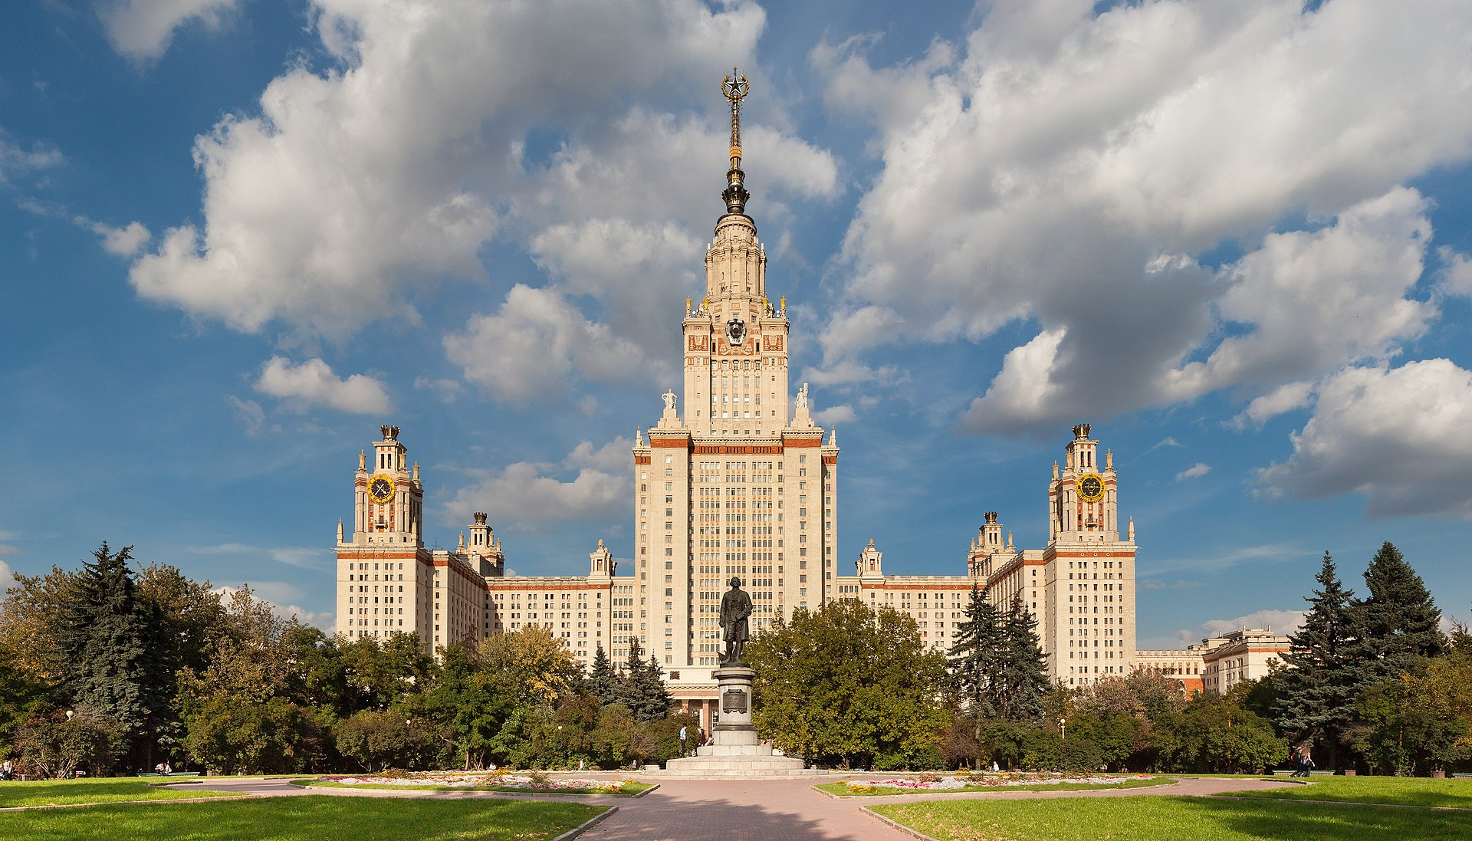
Moscow State University

Slide 2
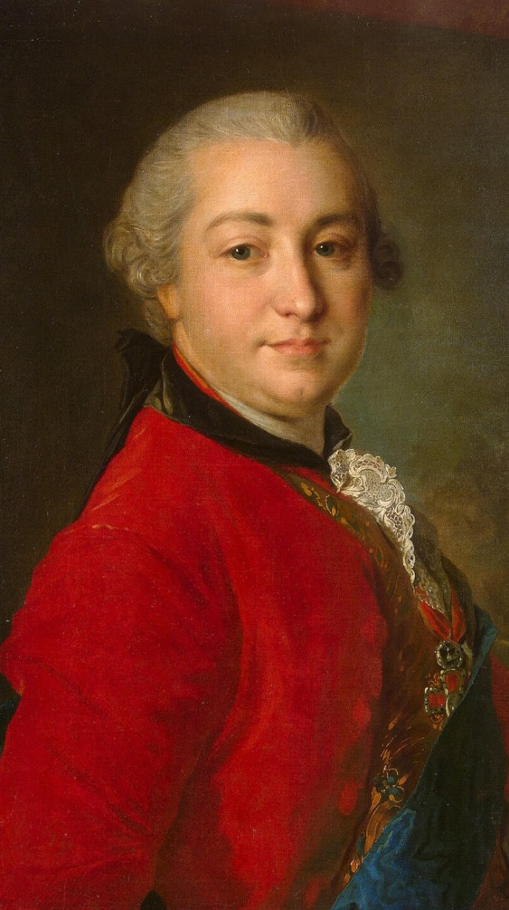
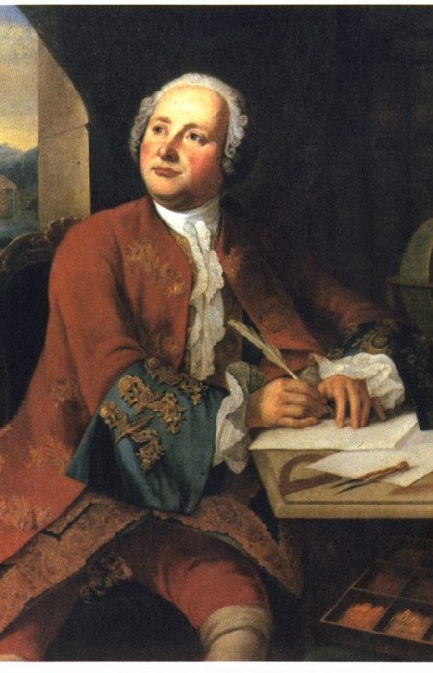
Created University I. I. Shuvalov and M. V. Lomonosov. Opened the University in the year one thousand seven hundred and fifty-fifth year. Each year, the University celebrates "Tatyana's day" in memory of its creation .The University has six buildings .Their area is equal to one million square .The University occupies the first place in Russia.

Slide 3
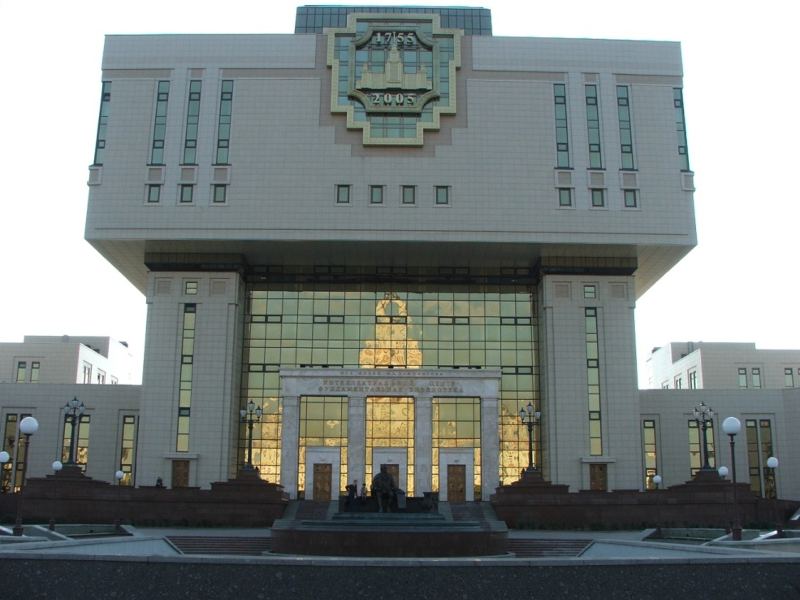
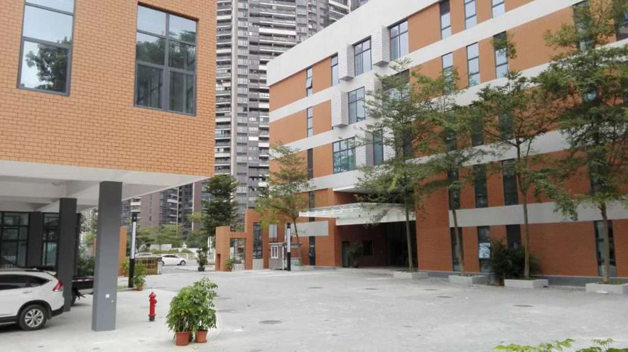
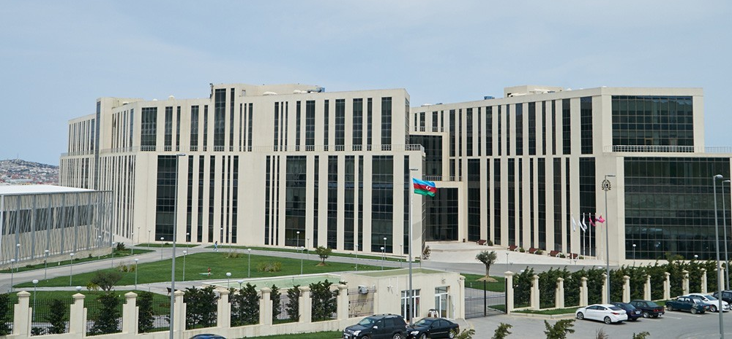

Slide 4
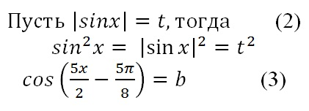
In order to enroll at MSU should be a single state exam on the very high scores. For one thing you need to no less than eighty-five points. It's really hard! But the exam is not enough ,that would be a MSU student ,you must pass exams at the University . It's called DWI ( additional entrance test)

Slide 5
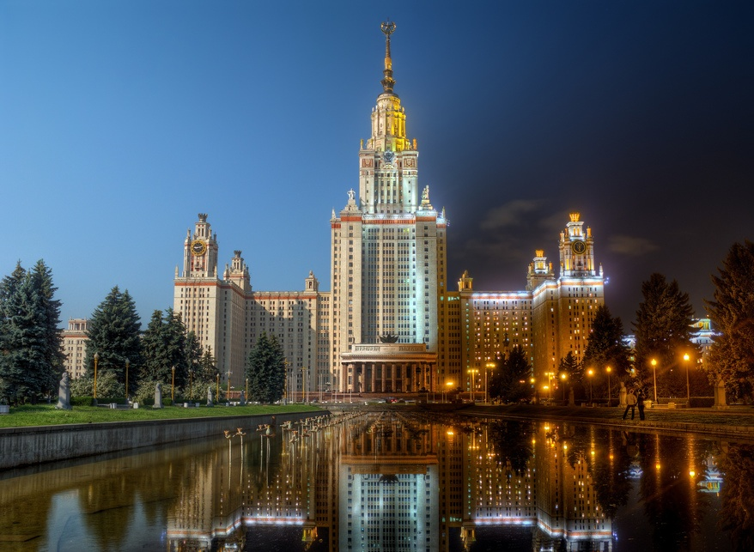
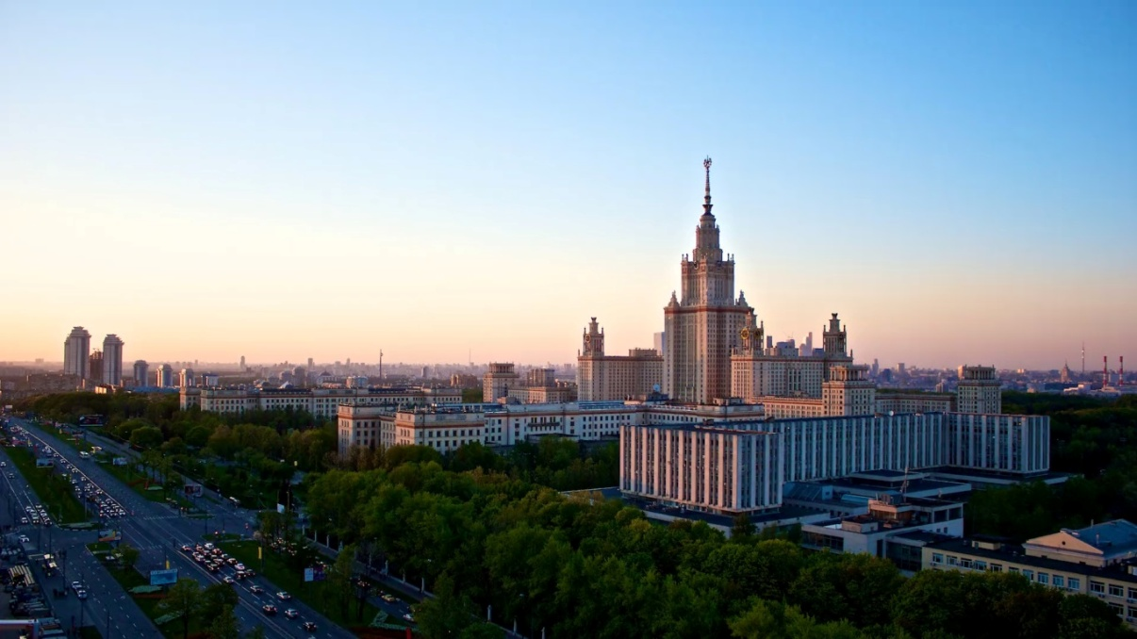
I believe that this is a very serious institution .You have to be very smart in order to study there. MSU requires a good knowledge in all fields of science . There are studied very smart people.

Slide 7
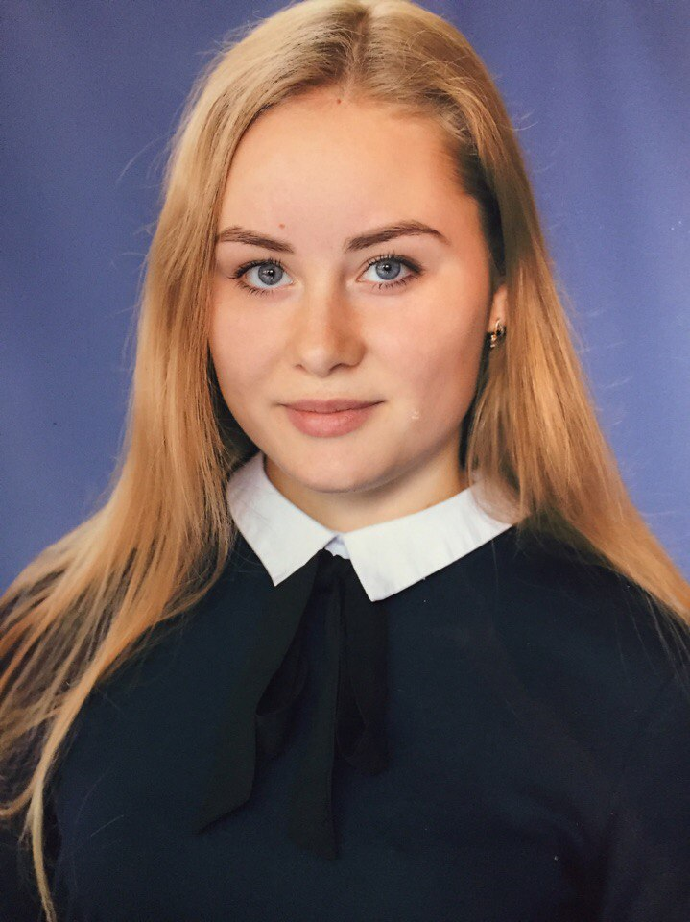
This project
was made by
the student of the 11 class
secondary school by
name of M.G.Gureev
Chekashkina Victoria

