Slide 1
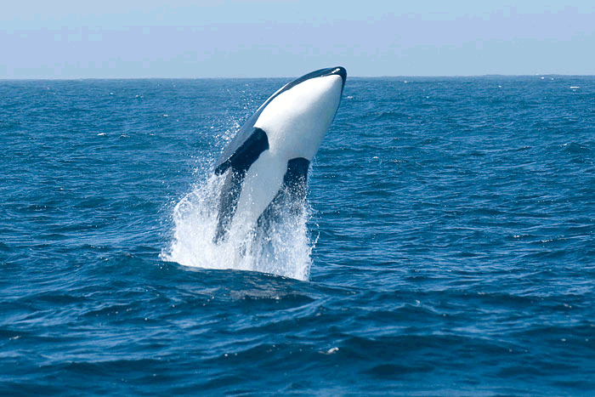
Викторина для 3 класса “Мир животных”

Slide 2
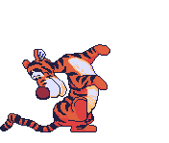
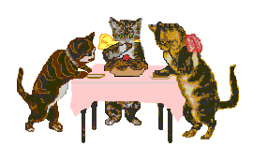
“OUR GRAMMAR STATION“ What are these animals doing?
1
2

Slide 3
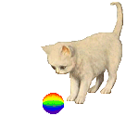
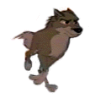
What are these animals doing?
3
4

Slide 4
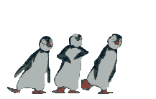
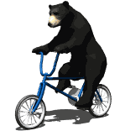
What are these animals doing?
5
6

Slide 5
What are these animals doing?
7 8

Slide 6
What are these animals doing?
9
10

Slide 7
What are these animals doing?
11
12

Slide 8
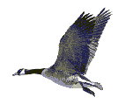
What are they doing?
13
14

Slide 9
The kitten … computer games every day.
play
is playing
plays

Slide 10
The snake … now.
sings
sing
is singing

Slide 11
The mouse … every evening.
read
is reading
reads

Slide 12
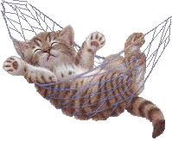
The cat … in the garden now.
sleep
sleeps
is sleeping

Slide 13
The bear …honey every morning.
eats
is eating
eat

Slide 14
The fish … now.
swim
swims
is swimming

Slide 15
The bird … every day.
fly
flies
is flying

Slide 16
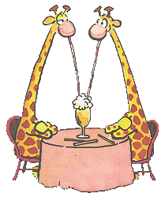
The giraffes … at the present moment.
drink
is drinking
are drinking

Slide 17
The dog … in the park every day.
run
runs
is running

Slide 18
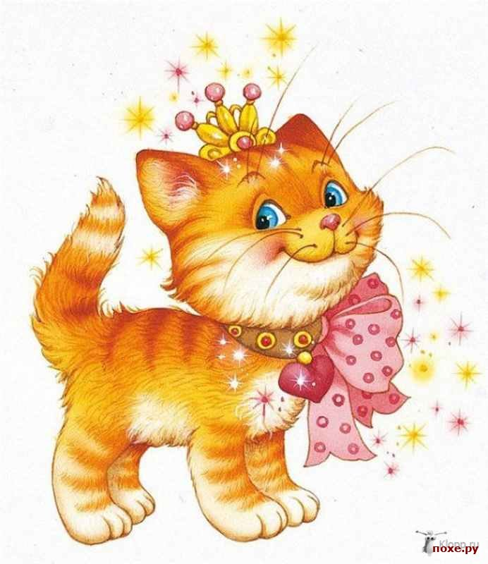
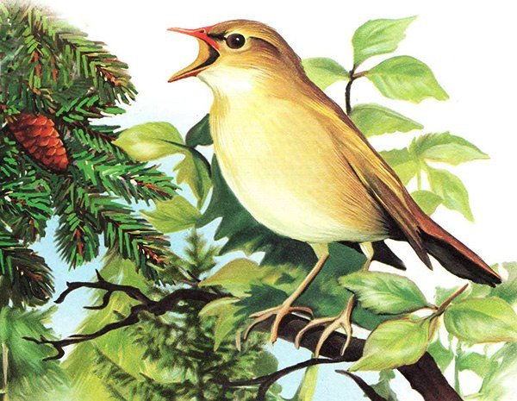
POEMS
I’m a cat.
I live in the flat.
I often sleep
On my cosy mat.
I’m a bird.
I get up early every day.
I like to sing.
I like to play.

Slide 19
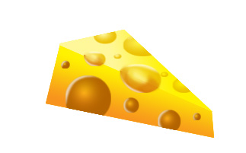
POEMS
I’m a mouse.
I live in the house.
When I see cheese
I always say “ Give me a piece, please”.
I’ m a butterfly.
I fly in the sky.
I rarely sit.
I usually fly.

Slide 20
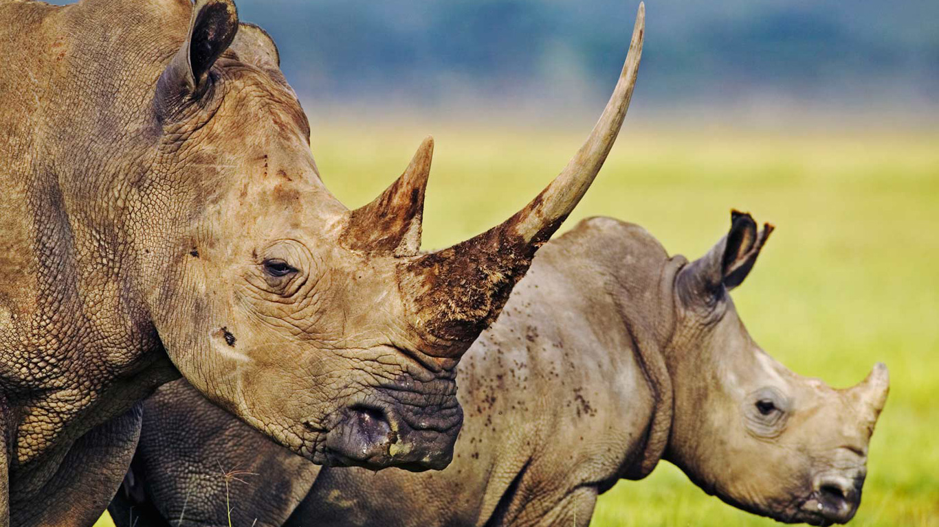
a . . . . .

Slide 21
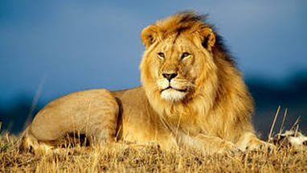
a . . . .

Slide 22
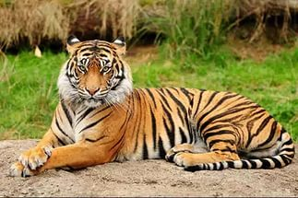
a . . . . .

Slide 23
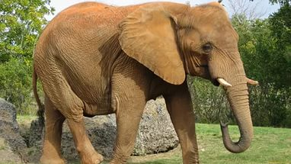
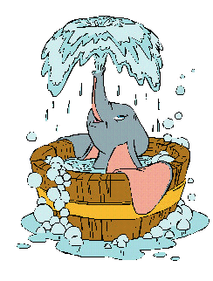
an . . . . . . . .

Slide 24
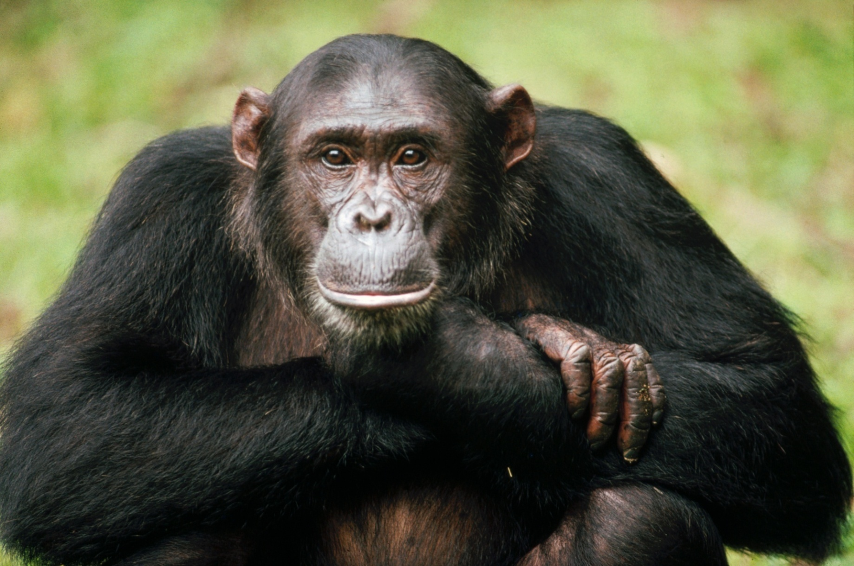
a . . . . . .

Slide 25
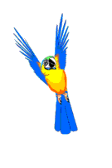
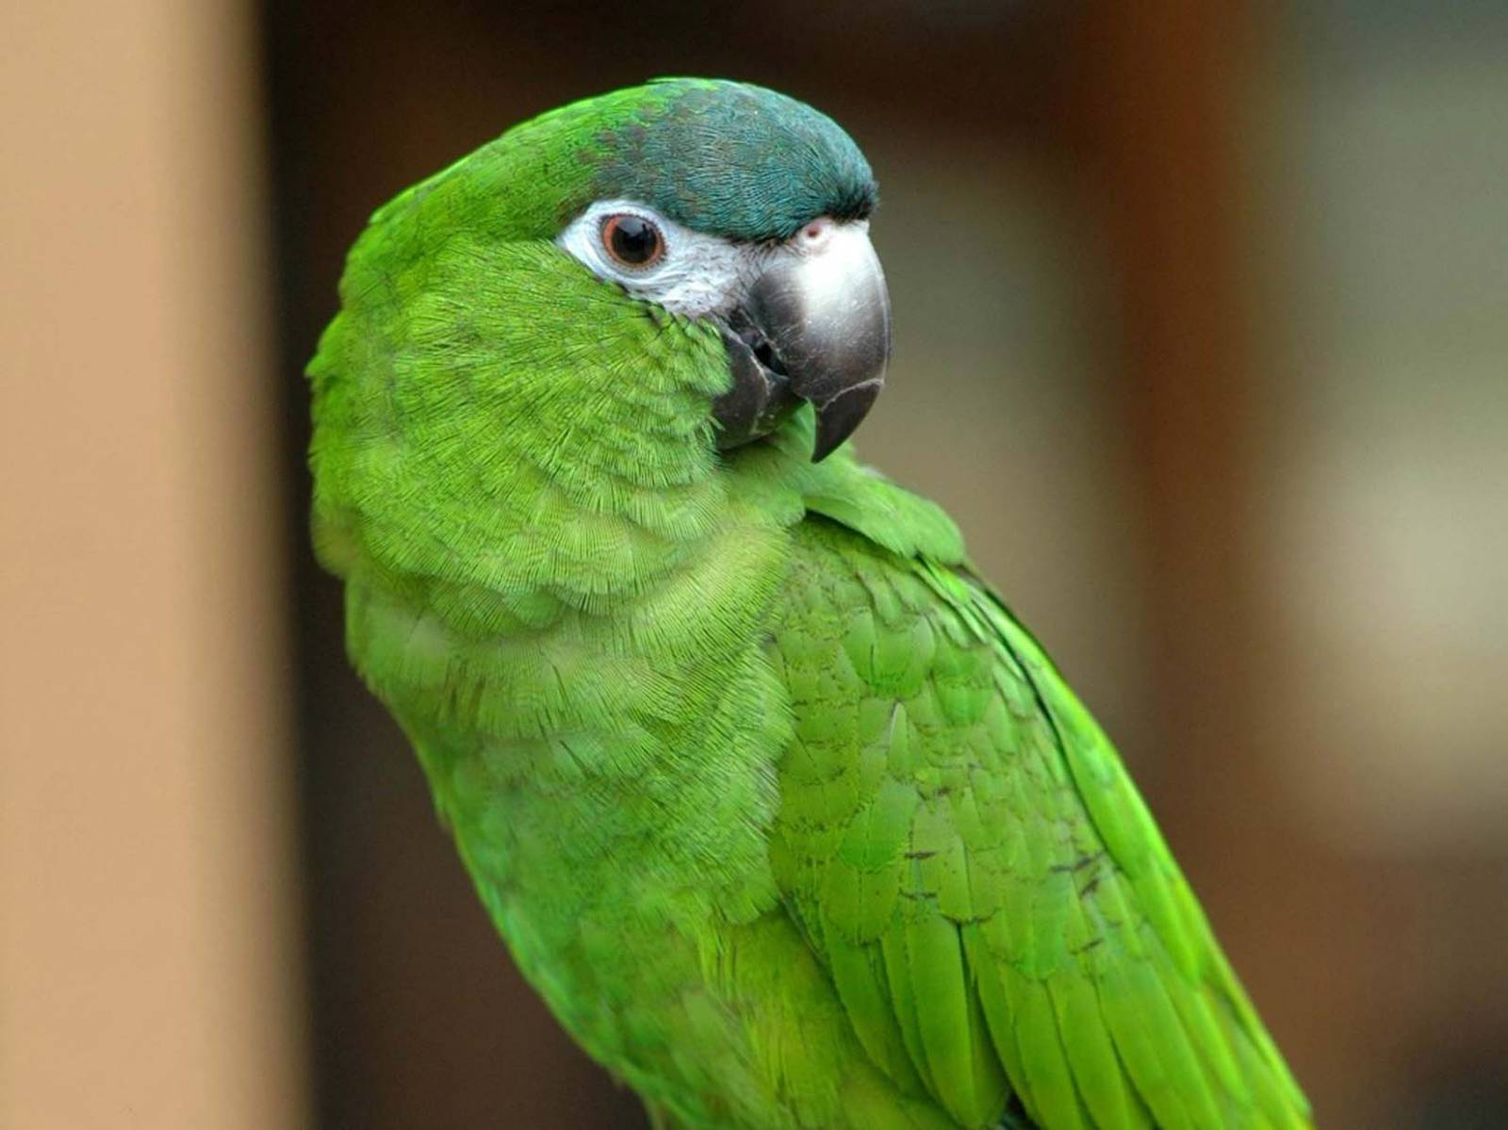
a . . . . . .

Slide 26
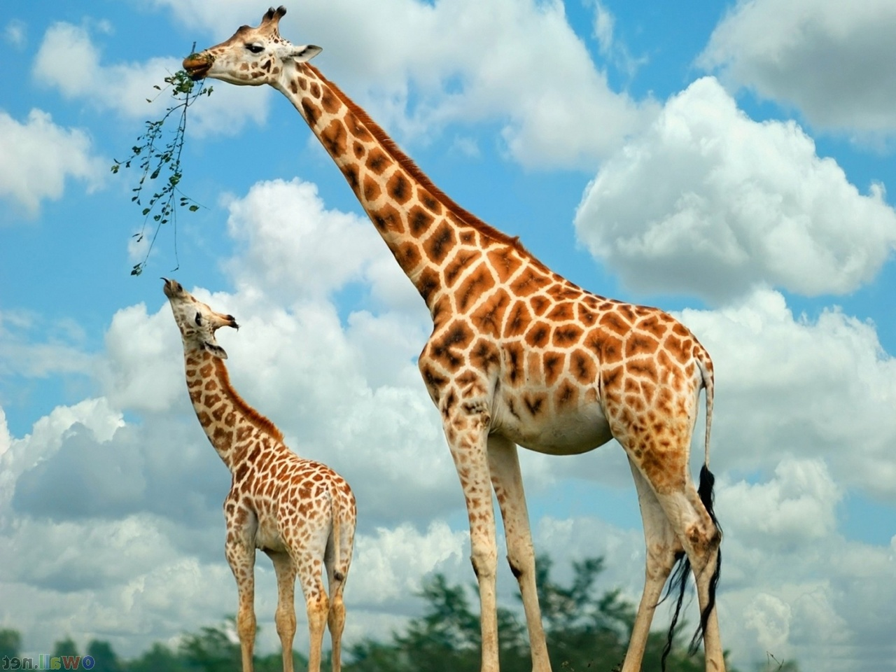
a . . . . . . .

Slide 27
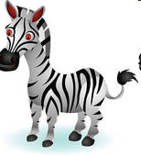
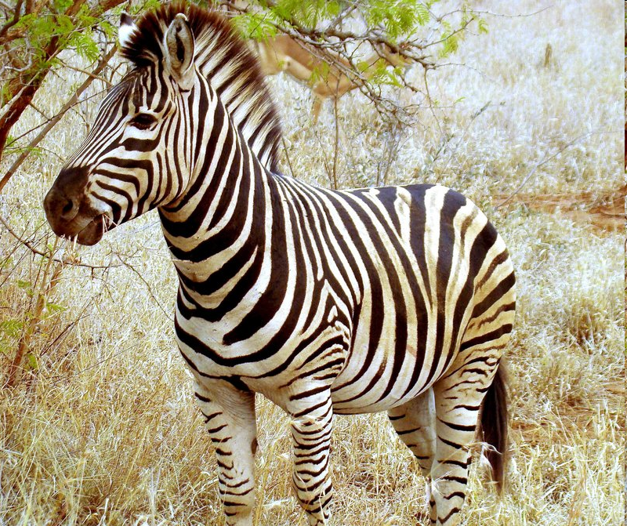
a . . . . .

Slide 28
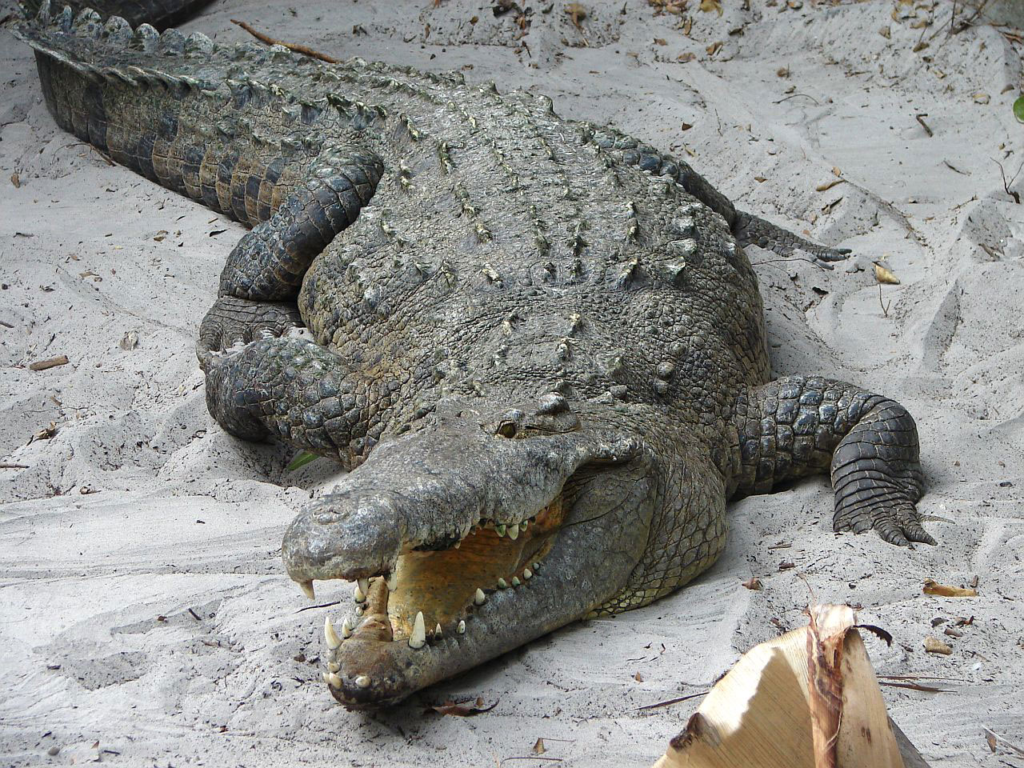
a . . . . . . . . .

Slide 29
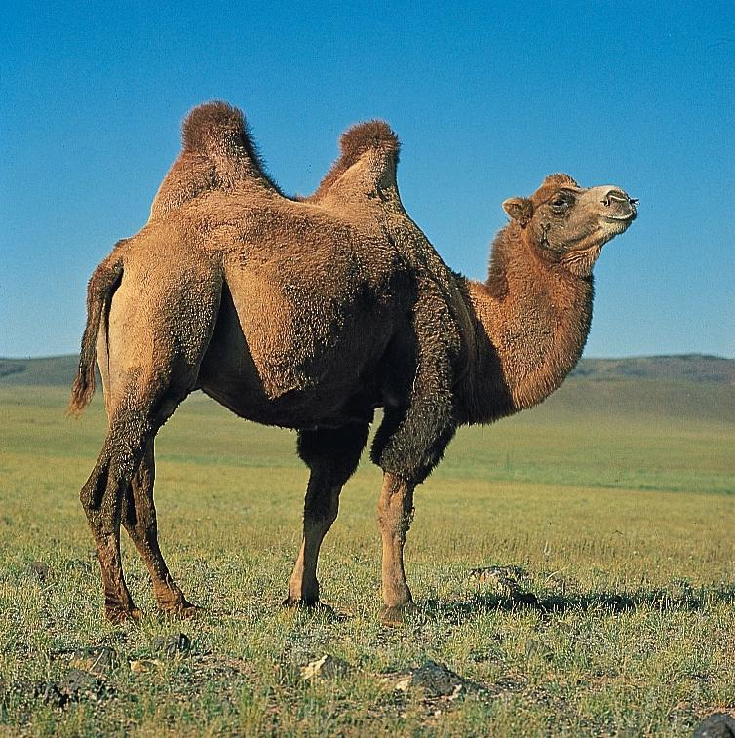
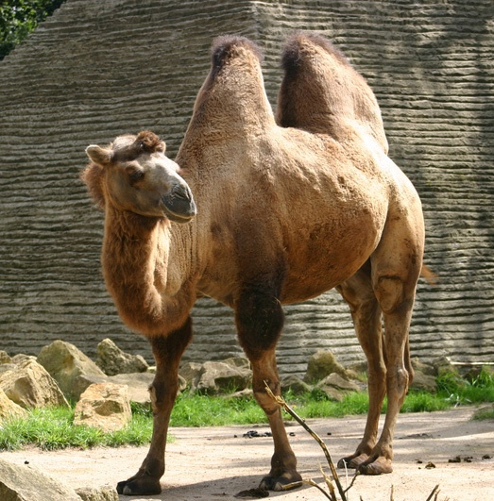
a . . . . .

Slide 30
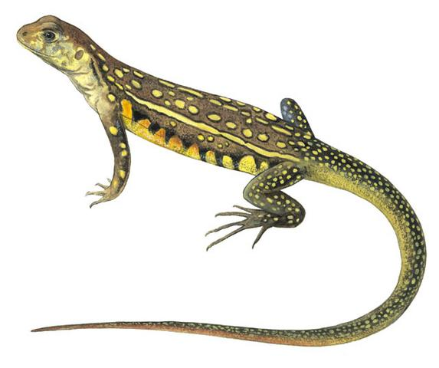
a . . . . . .

Slide 31
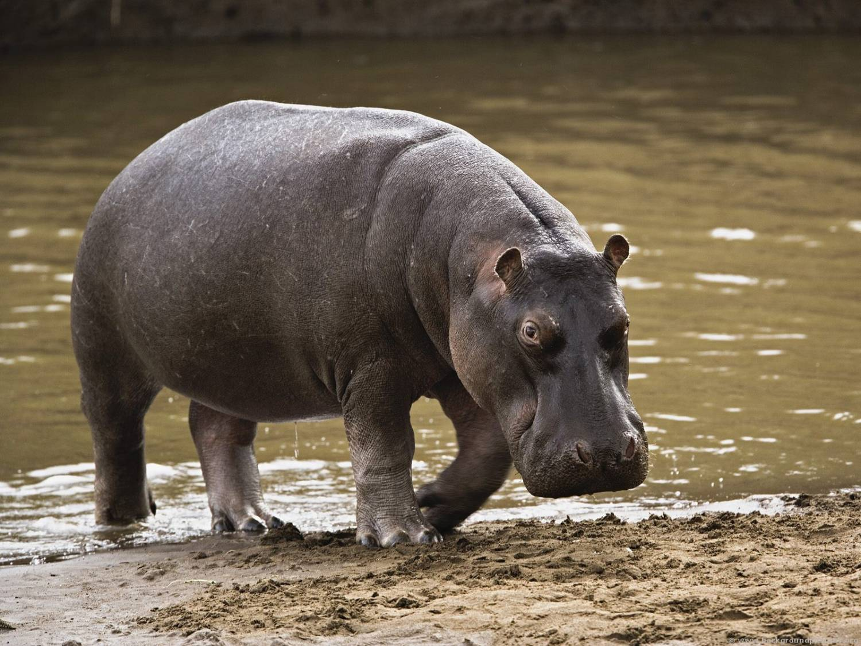
a . . . . .

Slide 32
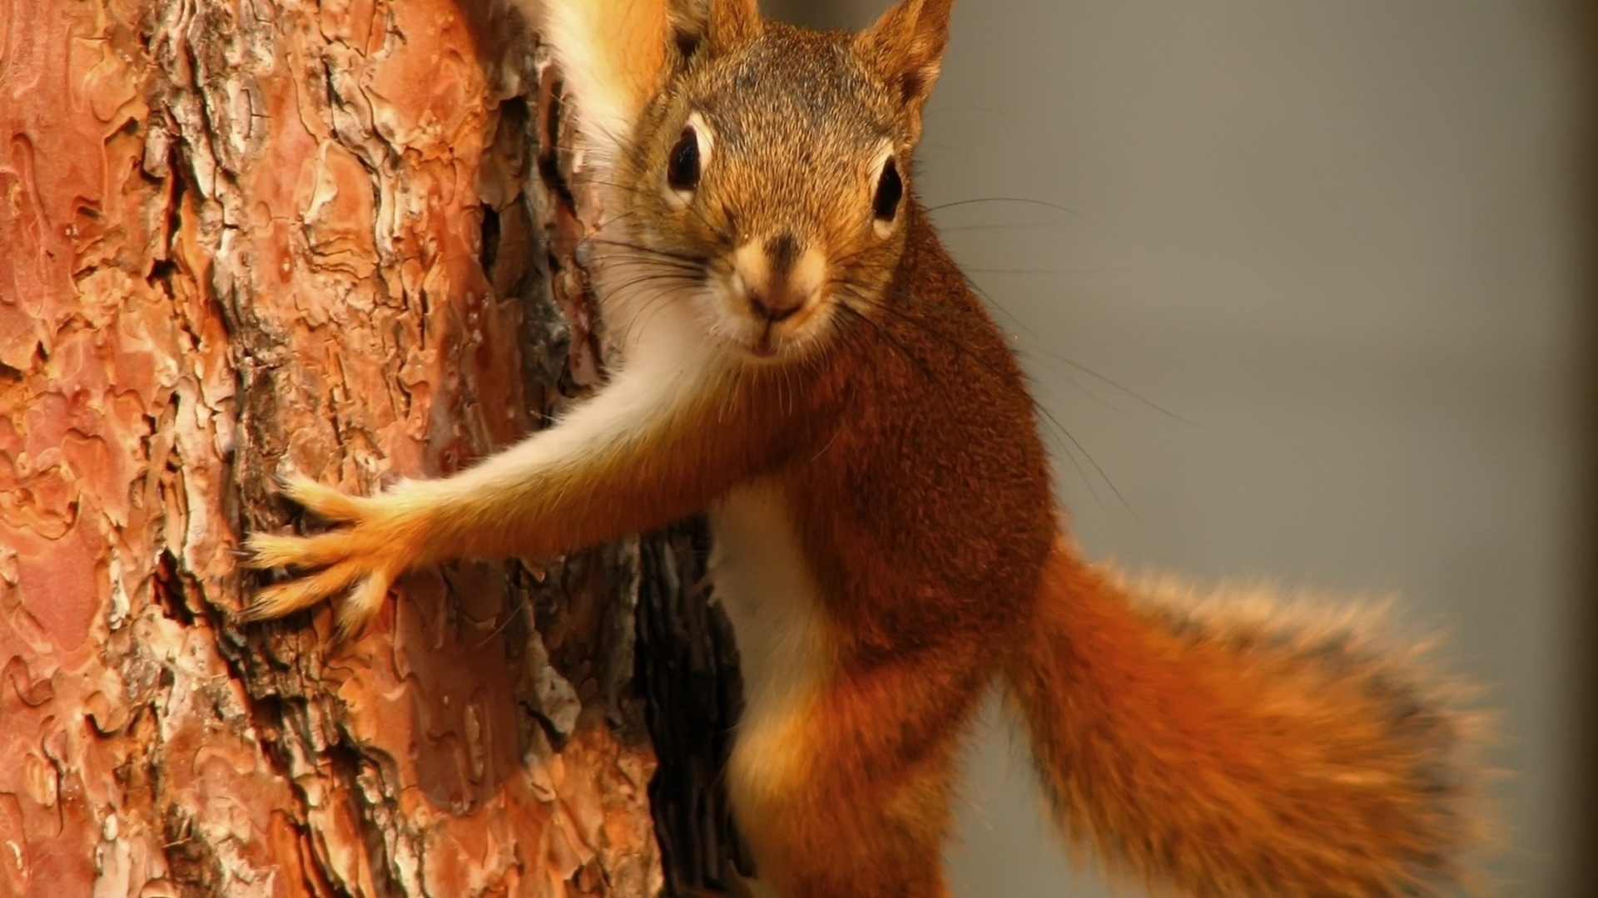
a . . . . . . . .

Slide 33
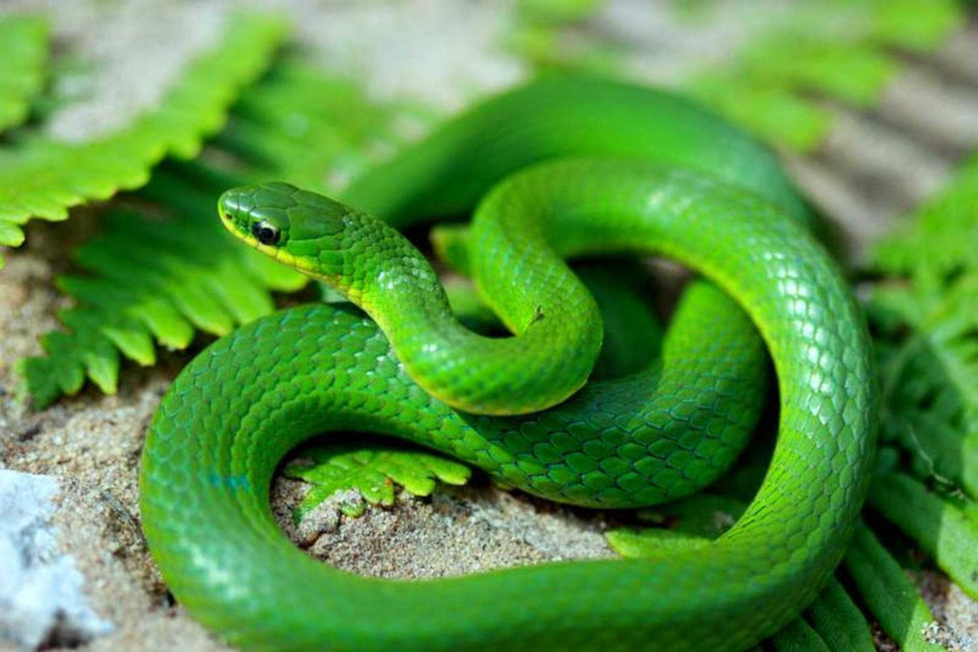
a . . . . .

Slide 34
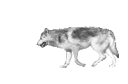
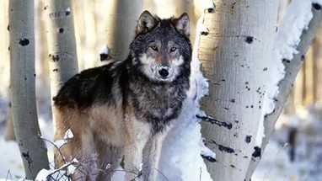
a . . . .

Slide 35
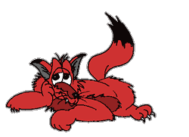
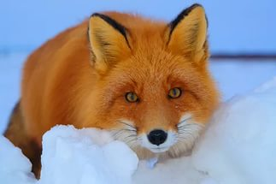
a . . .

Slide 36
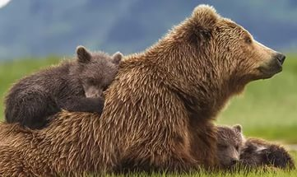
a . . . .

Slide 37
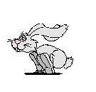
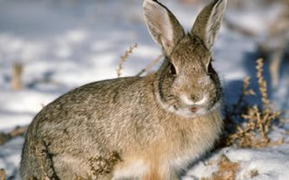
a . . . .

Slide 38
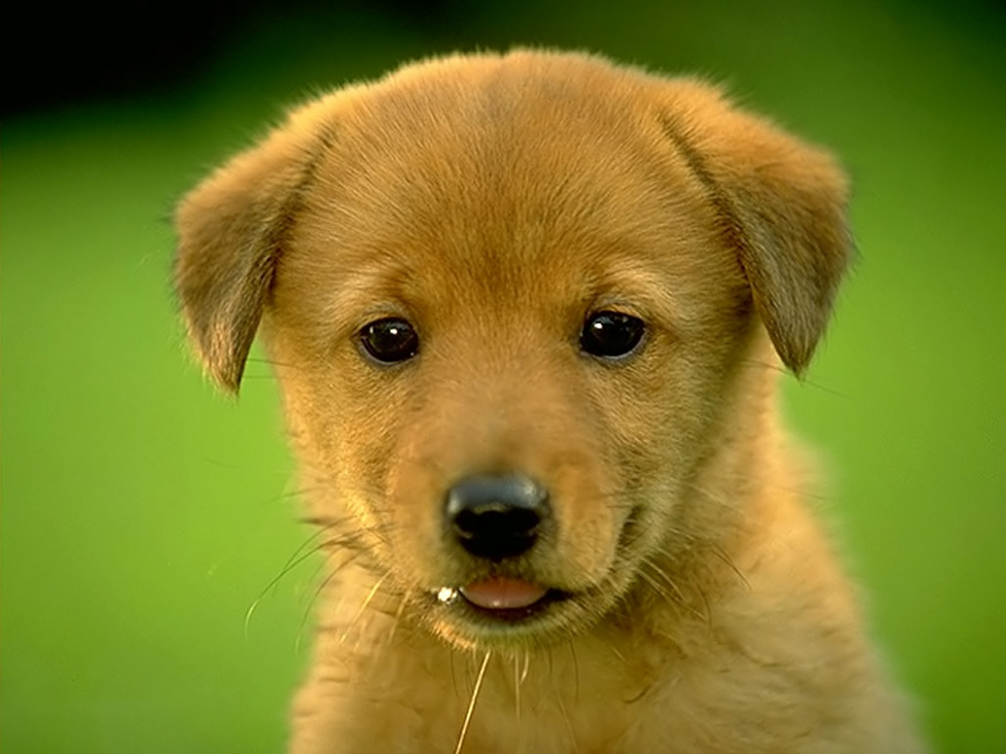
a . . . . .

Slide 39
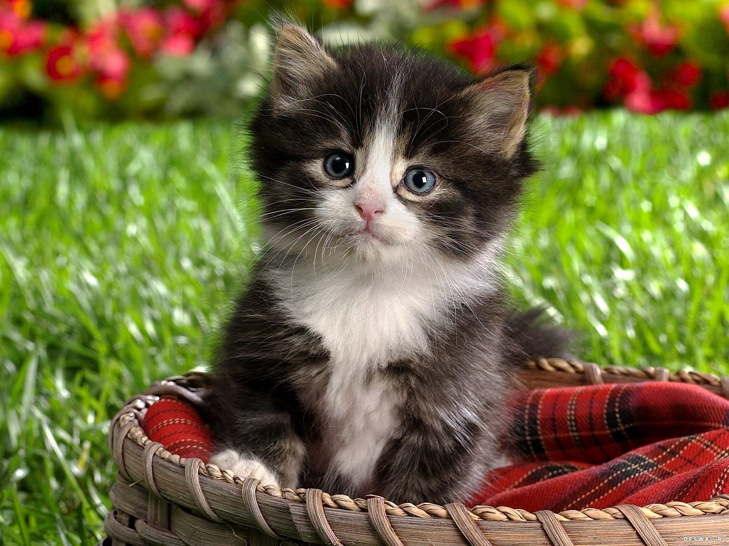
a . . . . . .

Slide 40
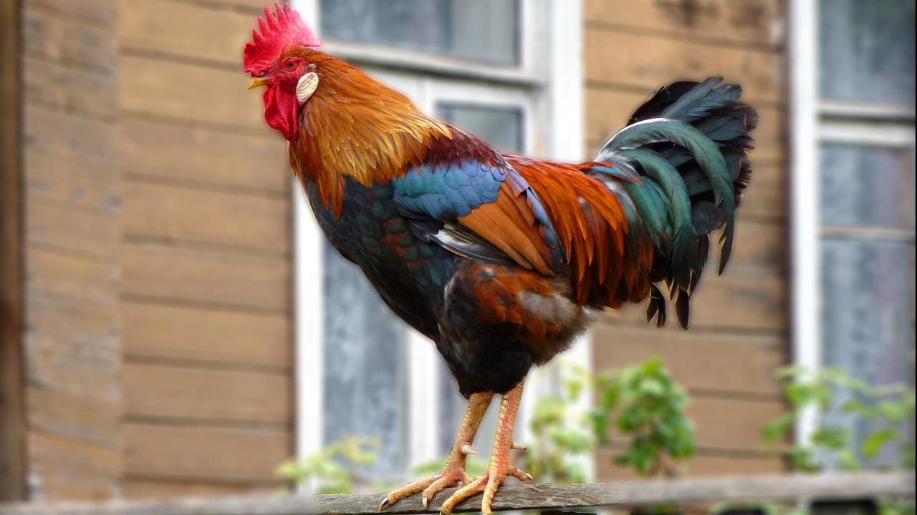
a . . . .

Slide 41
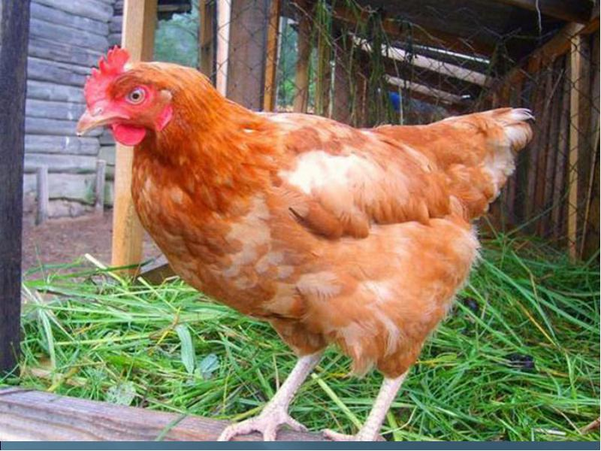
a . . .

Slide 42
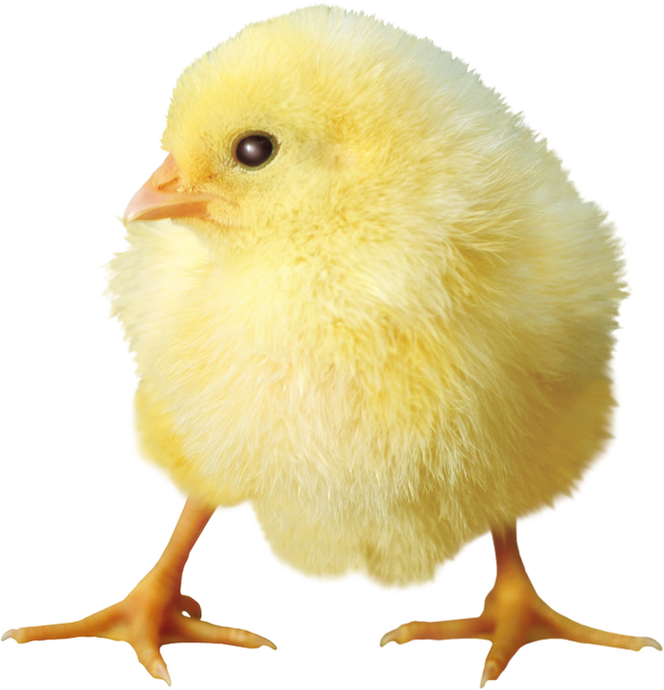
a . . . . . . .

Slide 43
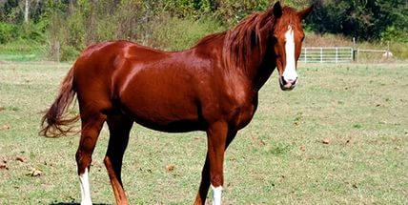
a . . . . .

Slide 44
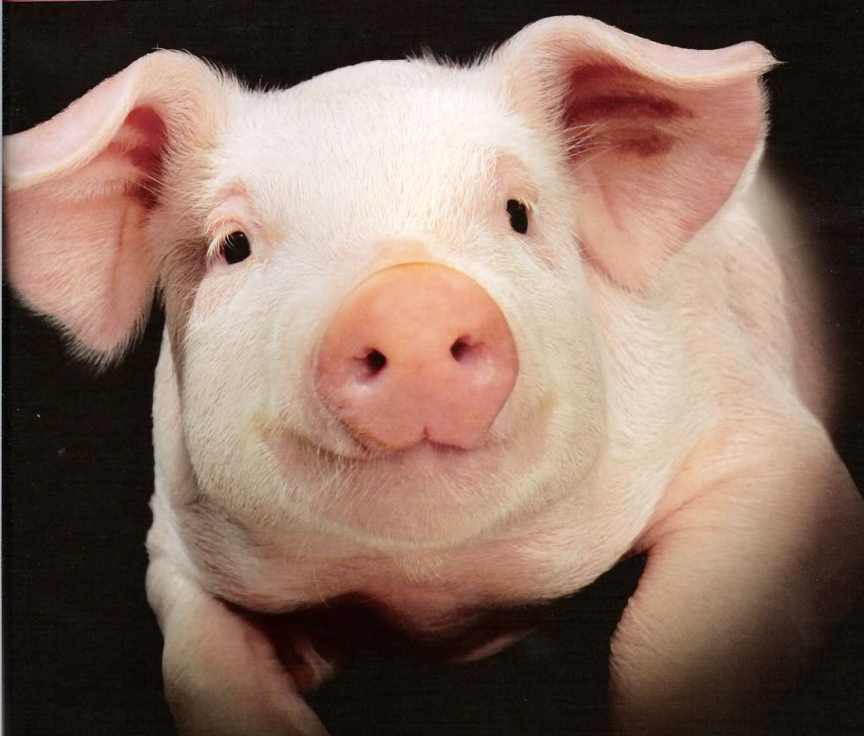
a . . .

Slide 45
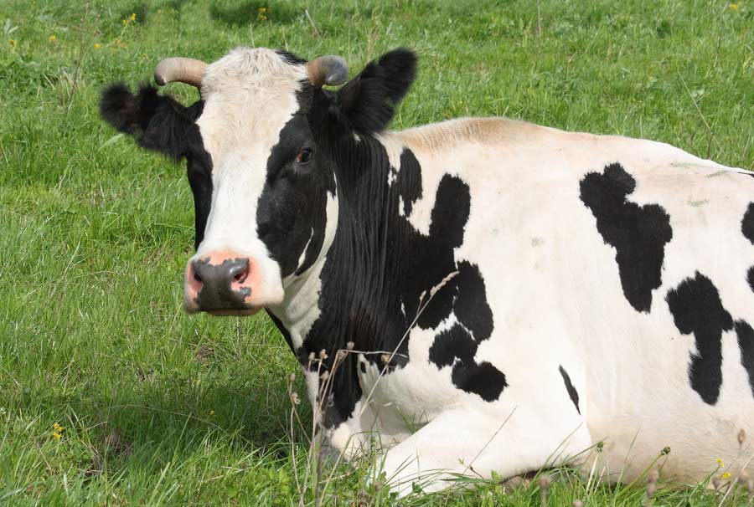
a . . .

Slide 46
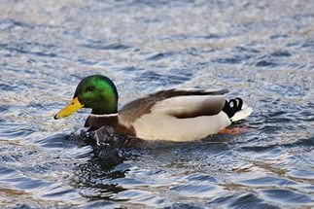
a . . . .

Slide 47
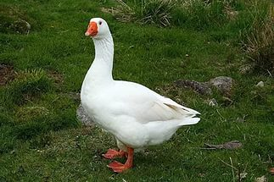
a . . . . .

Slide 48
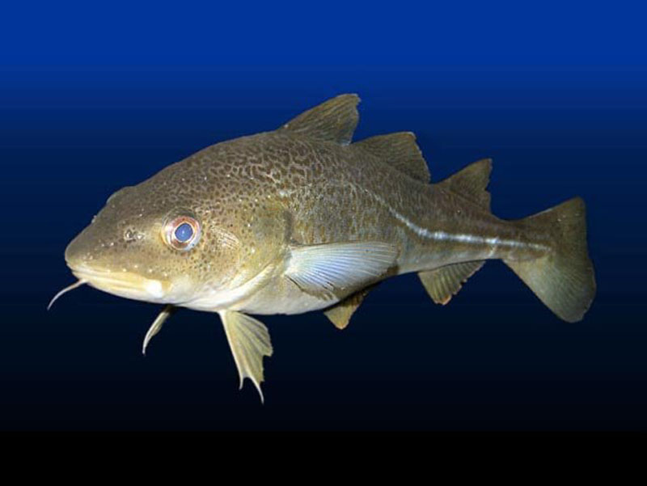
a . . . .

Slide 49
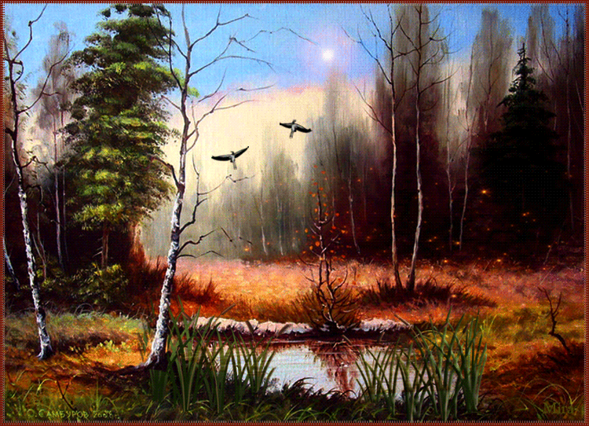
The station “ RIDDLES“

Slide 50
Find the animal

Slide 51
FIND THE ANIMAL

Slide 52
READING
The blue whale is the largest animal in the world. It likes shellfish. The blue whale has
got a long body and a big tail. It can swim fast,
but it cannot stay under the water for a long
time. Its colour is blue and grey.

Slide 53
READING
This is an emu. Emus are from Australia. They are very tall with a big body, a small head and long legs. Its head and neck are blue. The body and legs are brown. Emus can run very fast, but they cannot fly! Their eggs are green.

Slide 54
Thank you!

